Slide 1

Hola Tip

Slide 2
FinTech Startup to enable giving/receiving Cashless TIP via Mobile App. Market opportunity is estimated at $40 Billion annual.
Hola Tip

Slide 3
Problems worth solving
People have No change/cash to Tip
Forgot to Tip / Left place so can't Tip
Can't Tip before taking the services
People are not liking/wanting to Tip
Millennials going cashless so can't tip
Hola Tip

Slide 4
Our solutions
Cashless Tip from your mobile phone
Tip from anywhere, anytime & to anyone
Tip in advance & get better service
Tipping shows gratitude. Giving is cool
Encourage Tipping in Millennials
Hola Tip

Slide 5

Target market
Bar/Restaurant Staff
20M
Hotel & Resort Staff
Spa, Parlour, Valet
prospects
Retail, Events, Etc
Artists & Performers
Market size:
$40B
Hola Tip

Slide 6
Competitive landscape
Competitors | How our solution is better
No Tipping | Giving is Good. We make giving COOL now.
Cash | Go Cashless, Now Cashless Tip
Credit Card | Tip directly to Staff giving service
P2P Payment APPS | Focussed on Tipping. Integrate all APPs.
Hola Tip

Slide 7
Funding needed
$500K
Founder raising Seed Capital 100K. Remaining 400K to raise within 2 months of Launch for building team, infra & launch in global cities.
Hola Tip

Slide 8
Sales channels
Mobile App Stores platforms
Web presence & online signups
Digital & Social Media generating leads
Personal SignUp drives of Target Group
Registering Employment places of Target
Hola Tip

Slide 9
Marketing activities
Offline & Direct marketing/Street Team
Online & Social media campaigns
Sign Up Campaigns via personal visits
Alliances with Hotels, City Council
Trade Shows & PR on TV & Print
Hola Tip

Slide 10
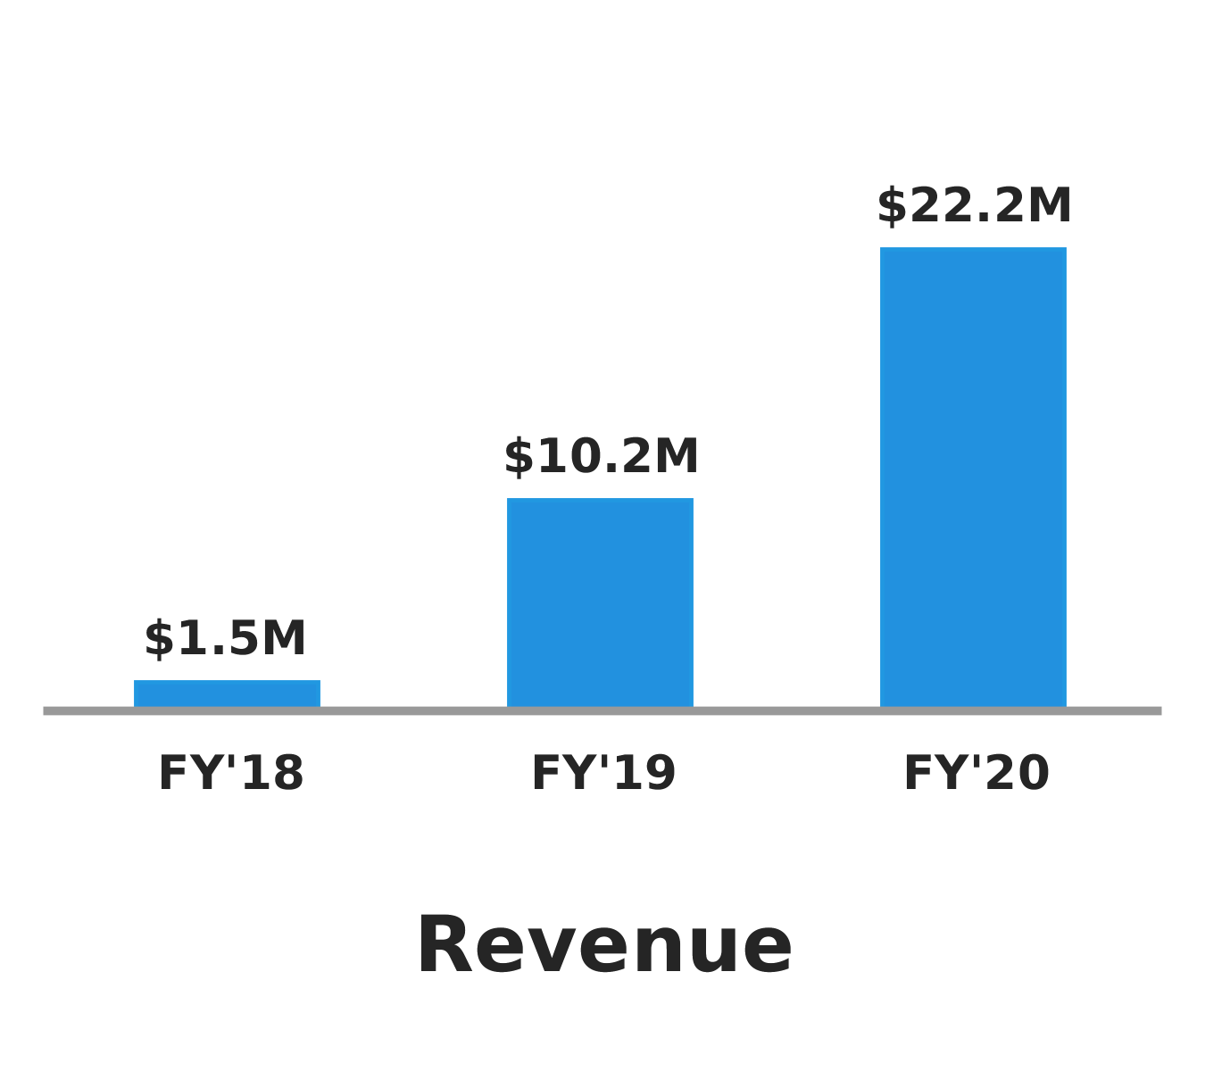
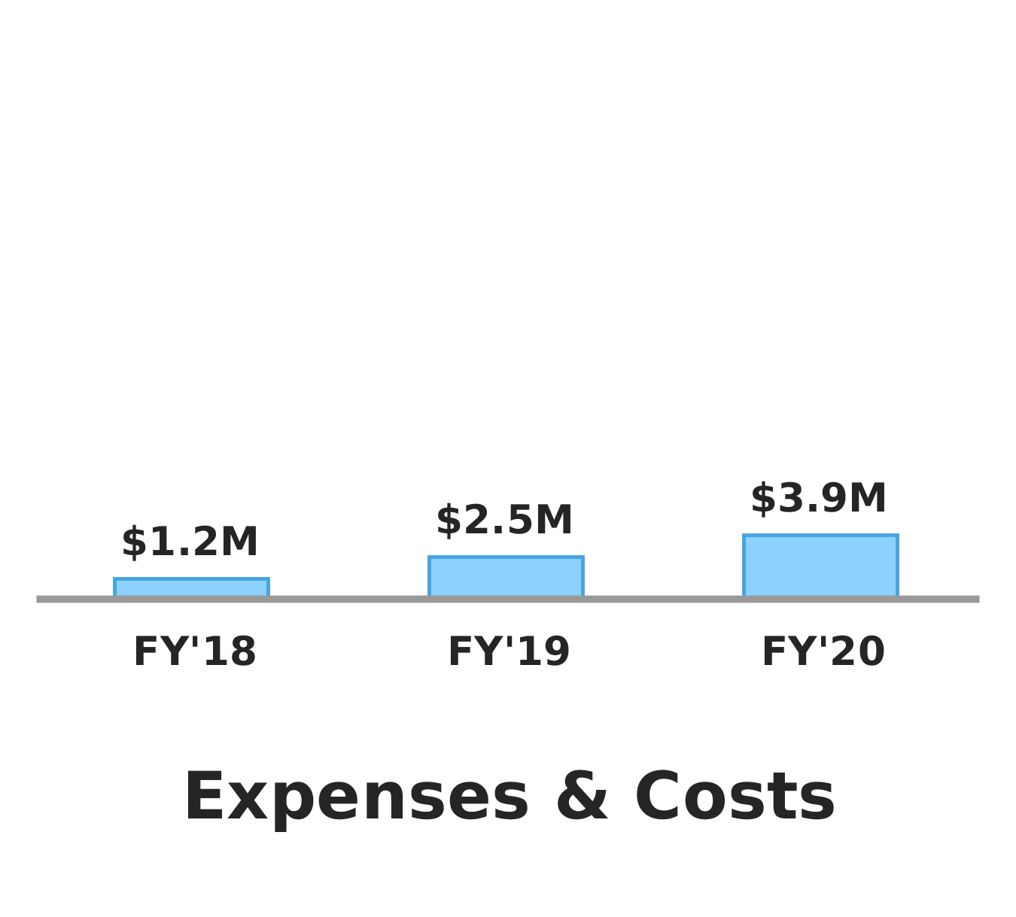
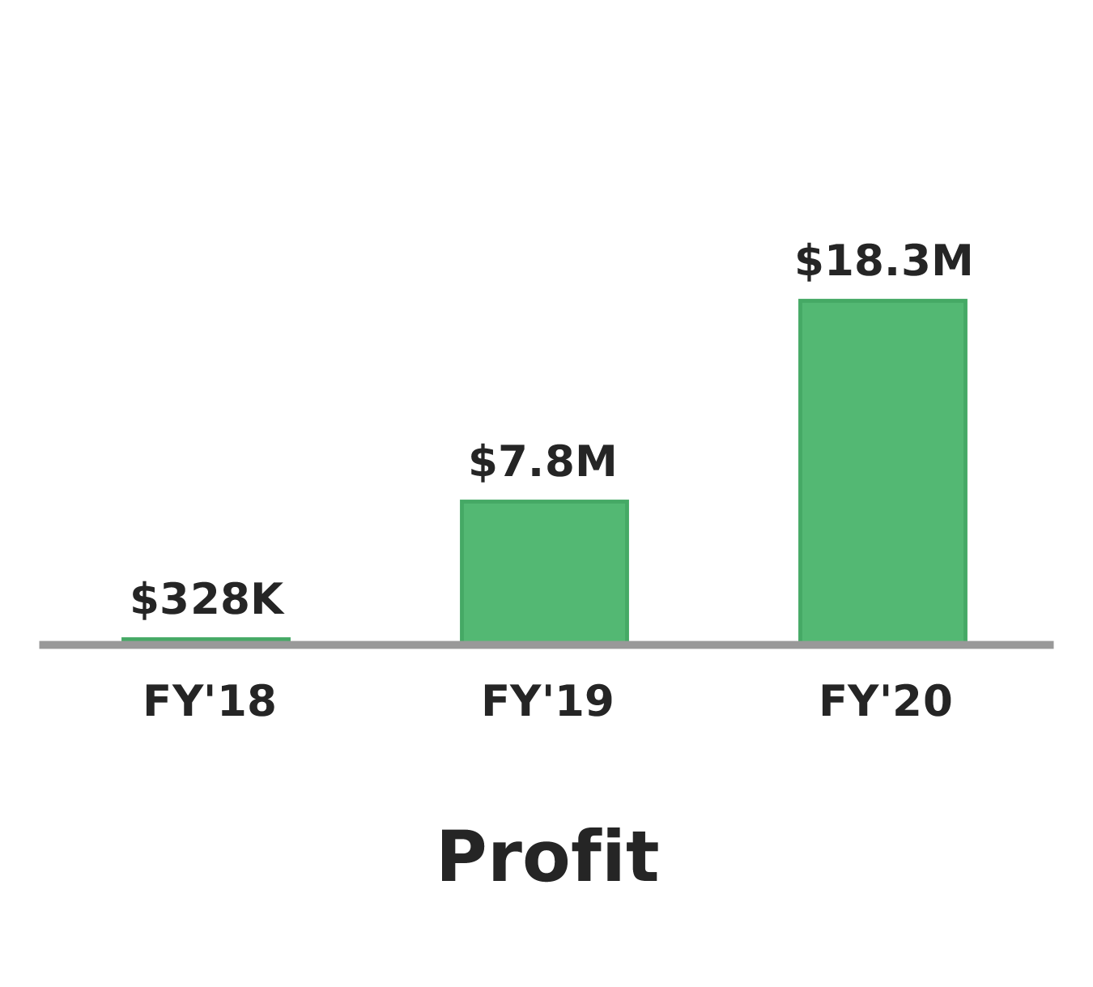
Financial projections
Hola Tip

Slide 11

Milestones
Date | Milestone
May 15, 2017 | Incorporating Company
May 30, 2017 | BETA Launch
June 15, 2017 | Official Launch
Hola Tip

Slide 12

Team and key roles
Rajesh Joshi
Founder
Hola Tip

Slide 13

Partners and resources
Auriga IT Solutions Private Limited
Team for Mobile App development & maintenance. They will be partner till we build Tech team in-house & also lend us resources for the same.
Hola Tip

